Slide 1
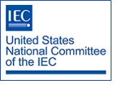
Module II-B
USNC/IEC Organizational and Governance Structure

Slide 2

Module II-B: Learning Objectives
This module provides an overview of the U.S. National Committee of the International Electrotechnical Commission (USNC/IEC)
  Membership
  Organization structure
  Governance and policy-setting bodies
  USNC Technical Advisory Groups (TAGs)

Slide 3
Module II-B: Disclaimer
The information contained in this self-taught
learning module is intended as a summary of documents and procedures frequently used within the IEC and the USNC/IEC.
For additional information about content addressed in this module, please contact the USNC/IEC Staff (usnc@ansi.org).
Additional information is also available via USNC/IEC Education & Training.

Slide 4
Reference Materials &
Source Documents
ISO/IEC Directives, Part 1: 2021
Procedures for the technical work
ISO/IEC Directives, Part 2: 2021
Rules for the structure and drafting of International Standards
ISO/IEC Directives, Part 1:2021 + IEC Supplement:2021
Procedures specific to IEC
IEC Statutes and Rules of Procedures
IEC membership and participation procedures
USNC Statutes: 2018
USNC Rules of Procedure: 2005
Model Operating Procedures for USNC/IEC TAGS: 2019
Guide for U.S. Delegates to meetings of ISO and the IEC
IEC Code of Conduct (Patent Policy included)
IEC Diversity Statement

Slide 5
U.S. National Committee of the IEC:
Strategic Objectives
Seek Leadership Positions at all levels of IEC and related activities
and work to guide and influence the structural and market positioning of the IEC in Global Markets consistent with U. S. electrotechnical positions
Grow USNC Membership through improvements in service, outreach, participation and diversity of the organization
Increase regional effectiveness of the USNC and the IEC
Develop comprehensive standards strategy
Develop comprehensive conformity assessment strategy
Build strong Consumer Involvement and Active Participation in the Management and Technical Levels of the IEC and USNC

Slide 6

USNC/IEC Membership
The broad-based USNC/IEC constituency represents the stakeholders in the U.S. electrotechnical community
The USNC/IEC includes representatives of academia, consumers, government agencies, manufacturers, professional societies, testing organizations, trade associations and more

Slide 7
USNC/IEC Membership (cont)
Members of the USNC are appointed by the USNC Council with the approval of the ANSI Executive Committee. ANSI Membership is a prerequisite for USNC Members. They must also:
  serve as US Technical Advisory Group (TAG) Administrators, USNC Conformity Assessment System Secretariats, or IEC Technical Committee (TC)/Subcommittee Committee (SC)/Systems Committees (SyC) Administrative Secretariats, and have paid all requisite fees,
  - or
  have expressed interest in participating in the USNC and have paid the USNC Premier Member fee.
  For more information about membership, please contact the USNC/IEC staff (usnc@ansi.org).

Slide 8
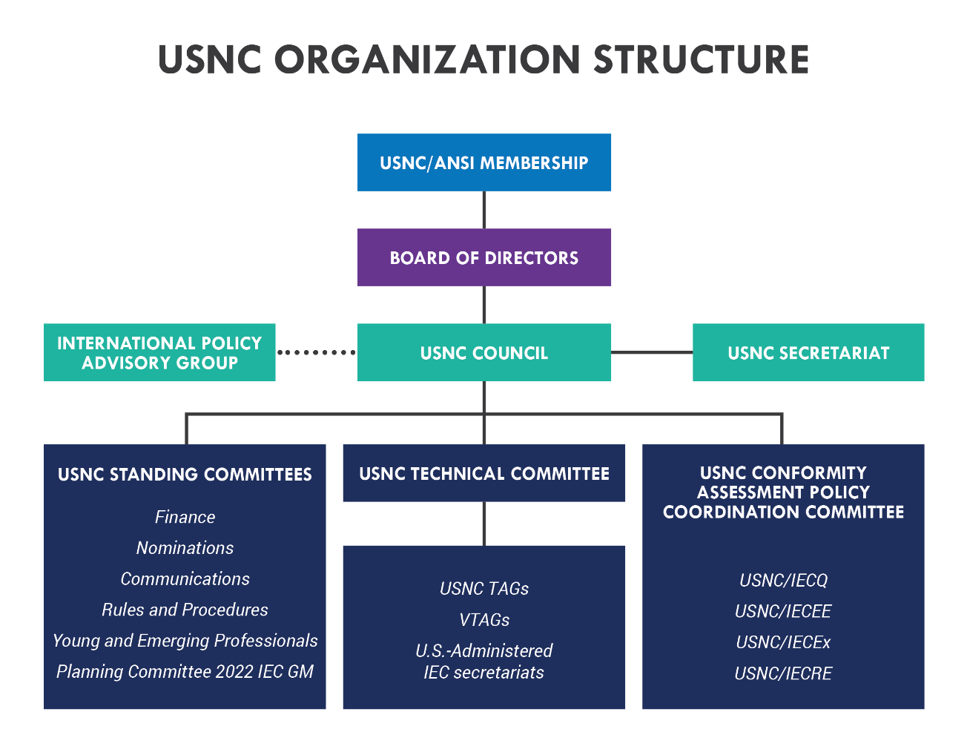
USNC/IEC Organizational Structure

Slide 9
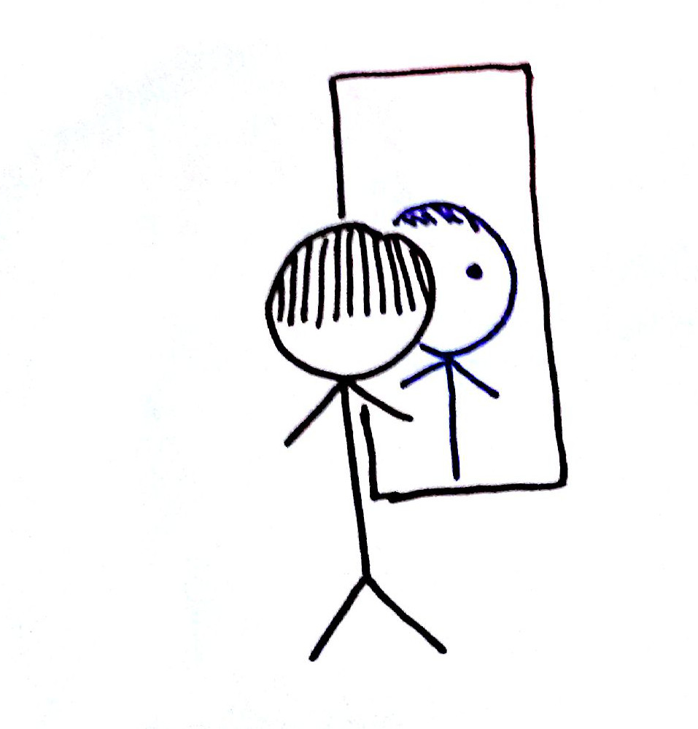
Look familiar?
That’s because the USNC “mirrors” the IEC structure
in order to best coordinate US positions for each of the respective IEC Council, Committees, and Groups

Slide 10
IEC/USNC Organization Structure:
Mirror Image Relationships
IEC Council
USNC
USNC Technical Management Committee (TMC)
IEC
USNC Council
IEC Council Board
USNC Council
IEC Standardization Management Board (SMB)
IEC Technical Committees (TCs)
USNC Technical Advisory Groups (TAGs)
IEC Conformity Assessment Board (CAB)
USNC Conformity Assessment Policy Coordination Committee (CAPCC)

Slide 11
USNC Participation in IEC
Policy and Management Activities
The USNC is one of six permanent Council Board members
  15 members total
The USNC is one of seven permanent Standardization Management Board (SMB) members
  15 members total
The USNC and its members participate in approximately 94% of Technical Committees and administer 21% of TC Secretariats

Slide 12
USNC Council

Slide 13

USNC Council
Represents and coordinates U.S. involvement in IEC on behalf of the U.S. electrotechnical community
Coordinates USNC activities with standards developers to promote consistency in IEC international and national activities

Slide 14
USNC Technical Management
Committee (TMC)

Slide 15
USNC Technical Management
Committee (TMC)
Manages the technical work of the USNC and represents the interests of the U.S. at the Standardization Management Board (SMB)
  Develops U.S. positions in preparation for IEC/SMB meetings
  Appoints and oversees the designation of Technical Advisors, Deputy Technical Advisors, and TAG Administrators
  Approves the designation of U.S. Secretariats to IEC Committees
  Authorizes invitations to host IEC Technical Committee (TC) and Subcommittee (SC) and Systems Committees (SyC) meetings in the U.S.
  Interfaces with regional/international bodies on technical issues
  Updates and approves USNC TAG Operating Procedures

Slide 16
USNC Technical Advisory Groups
(TAGs)

Slide 17

USNC TAGs
USNC-approved Technical Advisory
Groups (TAGs) develop the U.S. positions on technical – and certain policy – issues under consideration within the IEC technical committee structure
USNC TAGs are mirror committees of IEC TCs and SCs
TAGs provide the delegates who will represent the United States in technical committee discussions at IEC meetings and also the experts who will serve on WGs, PTs and MTs

Slide 18
USNC Technical Advisory Groups
(USNC TAGs)
U.S. Technical Advisory Groups (USNC TAGs) are
committees appointed by the USNC for participation in all IEC technical and certain IEC policy activities
  Any U.S. parties interested in and directly and materially affected by the work of the TC/SC may participate as members of a USNC-approved TAG
  The process for developing USNC positions provides an opportunity for fair and equitable participation without dominance by any single interest
  An annual TAG participation fee of $310 is required

Slide 19
USNC TAG Responsibilities
Development and maintenance of international standards in a specific technical area
  “Mirrors” relevant IEC committee
  Formed when new area of technical work is identified
Compliance with ISO/IEC Directives
Provides the U.S. delegations to technical committee meetings
Includes all relevant stakeholder interests

Slide 20

USNC TAG Responsibilities (cont)
Determines U.S. positions on
matters arising before international technical committees
  All U.S. positions developed by a TAG must be submitted to the relevant IEC committee by the USNC office
  U.S. Technical Advisors (TAs) for IEC committees are appointed by the USNC Technical Management Committee and operate in compliance with the USNC Operating Manual (see Module III-B for more information on TAs).

Slide 21
Criteria for Establishment of a USNC TAG
There shall be no undue financial barriers to participation
Participation shall not be conditional upon membership in any organization nor unreasonably restricted on the basis of technical qualifications or other such requirements
Guidelines for determining a U.S. voting position shall be provided and followed
Criteria for approval of U.S. positions on International Standards shall be met
At least three (3) voting members are required for viability

Slide 22

USNC TAG Procedures
All USNC/IEC TAGs may choose to adopt:
  the Model Operating Procedures for USNC/IEC Technical Advisory Groups
  or
  their own procedures, which must be equivalent to or more stringent than the TMC-approved model procedures and conform to the essential requirements of the Model Operating Procedures for USNC/IEC Technical Advisory Groups

Slide 23
Example IEC/TC and
USNC TAG Relationship
IEC Technical Committee (TC)
USNC Technical Advisory Group (TAG)
TC 37
Surge Arresters
SC 37A
Low-voltage surge protective devices
SC 37B
Components for low-voltage surge protection
TAG for TC 37
Surge Arresters
TAG for SC 37A
Low-voltage surge protective devices
TAG to SC 37B
Components for low-voltage surge protection

Slide 24

USNC Funding
In 1998, the ANSI Board of Directors challenged the USNC/IEC to become a self-supporting entity
  The USNC is a totally integrated committee of ANSI
  ANSI provides administrative support to the USNC
  ANSI provides the fiduciary framework by which the USNC’s financial obligations are met, including the payment of annual dues to the IEC
With the exception of membership fees, the USNC receives no subsidies from other organizations or financial support from the U.S. government
Numerous funding options were considered and a “Pay to Play” philosophy was ultimately adopted by the USNC/IEC Council
  Determined to be the fairest, most equitable and least onerous payment mechanism

Slide 25
USNC Funding
“Pay-to-Play”
  Modest, across-the-board fee for all individual TAG Participants (currently $310 annual fee; $620 for TAGs serving two or more TC/SC/SyCs)
    ANSI membership is not required
    Exemptions, waivers, etc. are considered on a case-by-case basis
  ANSI members (companies, organizations and government agencies) can become USNC Premier Members for an annual fee of $6,600
    Individual TAG participation fees are waived for any employee of that company, organization or agency

Slide 26
USNC Conformity Assessment Policy Coordination Committee (CAPCC)

Slide 27
USNC Conformity Assessment Policy Coordination Committee (CAPCC)
Manages the conformity assessment work of the USNC and represents the interests of the U.S. at the Conformity Assessment Board (CAB)
  Develops U.S. positions in preparation for IEC/CAB meetings
  Appoints and approves Secretariats of the four US conformity assessment mirror committees;
    IECEE
    IECEx
    IECQ
    IECRE
  Interfaces with regional/international bodies on conformity assessment issues

Slide 28
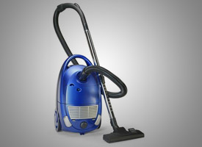

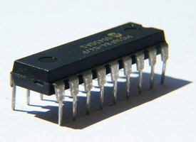

USNC Four Conformity
Assessment Systems
IECEE
  Electrical equipment: safety and performance
IECEx
  Hazardous environments
IECEQ
  Electronic components
IECRE
  Renewable energies

Slide 29
USNC Standing Committees

Slide 30

USNC Standing Committees
Finance Committee (FinCom)
Nominations Committee (NomCom)
Communications Committee (ComCom)
Young and Emerging Professionals (YEP)
Rules and Procedures (R&P)
Planning Committee 2022 IEC GM (PlanCo)

Slide 31
USNC Constituent Training Program
Module II-B
Complete

Slide 32
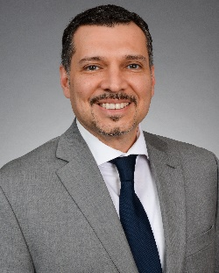
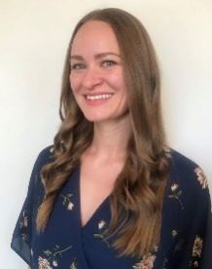


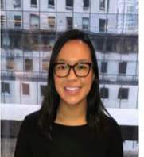
The USNC Team
Tony Zertuche
USNC General Secretary
Director, International Policy (ANSI)
Megan Pahl
USNC Program Administrator
Adelana Gladstein
USNC Program Manager
Debbie Negron-Badillo
USNC Meetings Coordinator
Chynna Anuszewski
USNC Program Administrator

Slide 33
USNC Staff Contact Information
Joe Tretler
Vice President, International Policy
jtretler@ansi.org
(202) 331-3618
Tony Zertuche
Director, International Policy
& USNC General Secretary
tzertuche@ansi.org
(212) 642-4892
Adelana Gladstein
Program Manager
agladstein@ansi.org
(212) 642-4965
Chynna Anuszewski
Program Administrator
canuszewski@ansi.org
(212) 642-8927
Megan Pahl
Program Administrator
mpahl@ansi.org
(212) 642-8907
Debra Negron-Badillo
USNC Meetings Coordinator
dnegron@ansi.org
(212) 642-4936

Slide 34
USNC of the IEC
American National Standards Institute
25 West 43rd Street
Fourth Floor
New York, NY 10036
usnc@ansi.org
www.ansi.org/unc |www.ansi.org | webstore.ansi.org

